Slide 1
Machine Learning Decision Tree (ch 6)
Dr. Malak Abdullah
Computer Science Department
Jordan University of Science and Technology

Slide 2
Decision Tree
Decision Tree : Decision tree is the most powerful and popular tool for classification and prediction. A Decision tree is a flowchart like tree structure, where each internal node denotes a test on an attribute, each branch represents an outcome of the test, and each leaf node (terminal node) holds a class label.
Decision tree is a type of supervised learning algorithm (having a pre-defined target variable) that is mostly used in classification problems. It works for both categorical and continuous input and output variables. In this technique, we split the population or sample into two or more homogeneous sets (or sub-populations) based on most significant splitter / differentiator in input variables.
The decision tree algorithm tries to solve the problem, by using tree representation. Each internal node of the tree corresponds to an attribute, and each leaf node corresponds to a class label.
The main drawback of Decision Tree is that it generally leads to overfitting of the data

Slide 3
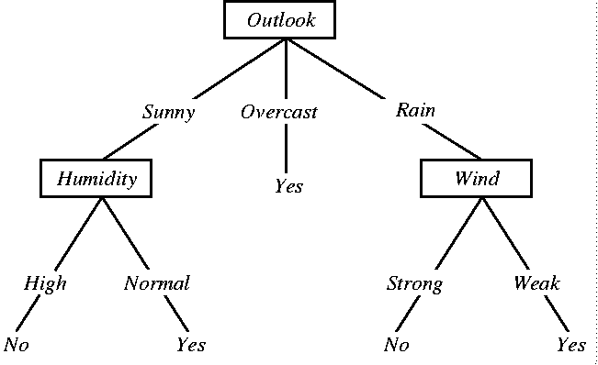
A Simple Decision Tree

Slide 4
Terminology
Root = Outlook
Depth =2
Leaf = No, Yes, Yes, No, Yes
a binary tree, each parent node must have at most 2 child nodes
internal node = attribute test
branch = attribute value
leaf node = classification

Slide 5
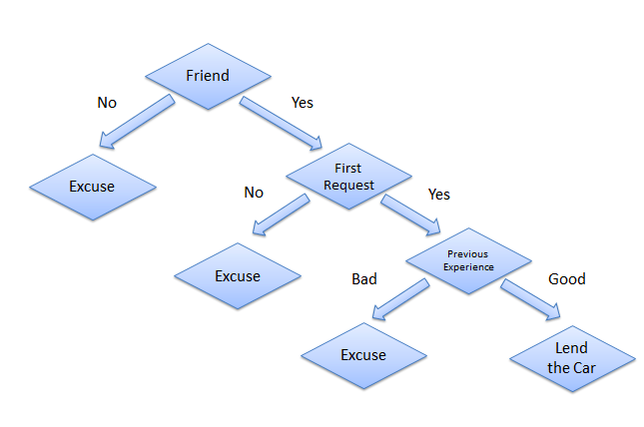
Example from the life
Consider a scenario where a person asks you to lend them your car for a day, and you have to make a decision whether or not to lend them the car. There are several factors that help determine your decision, some of which have been listed below:
Is this person a close friend or you just slightly know him? If he is not a close friend, then decline the request; if the person is a friend, then move to next step.
Is the person asking for the car for the first time? If so, lend them the car, otherwise move to next step.
Was the car damaged last time they returned the car? If yes, decline the request; if no, lend them the car.

Slide 6
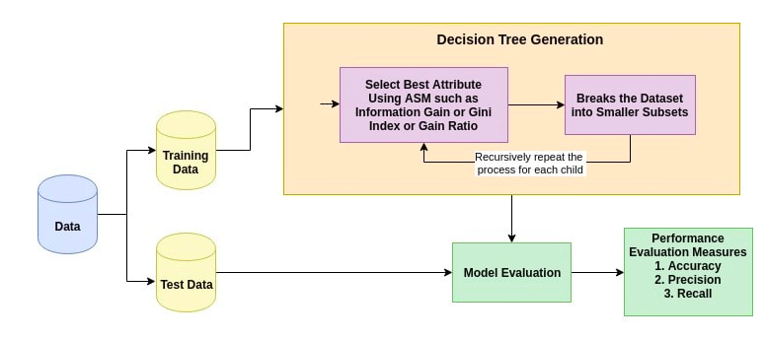
Assumptions while creating Decision Tree
At the beginning, the whole training set is considered as the root.
Feature values are preferred to be categorical. If the values are continuous then they are discretized prior to building the model.
Records are distributed recursively on the basis of attribute values.
Order to placing attributes as root or internal node of the tree is done by using some statistical approach.

Slide 7
Splitting
Trying to find and return the smallest possible decision tree that accurately classifies the training set is very very hard. In fact, it’s an NP-hard problem.
Instead, we’ll try to approximate the best result instead of getting the best result. We’re going to talk a lot about probability and statistics.
What we want is information that explicitly splits the data into two. We don’t want something that can include both A and B classes, we want purity. One singular class for each split.
The measure of purity is called information. It represents the expected amount of information that would be needed to specify whether a new instance should be classified as the left or right split.
Gini or Entropy are measures of impurity. How uncertain something is.

Slide 8
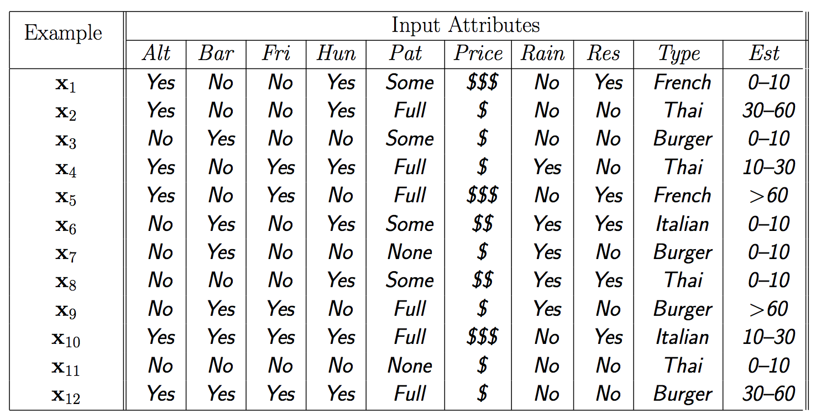
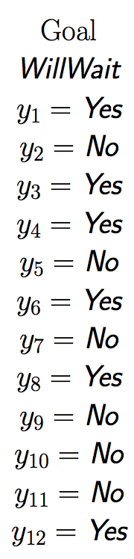
Training data

Slide 9
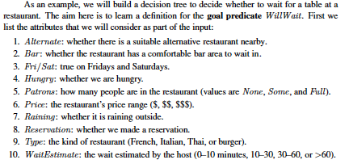

Slide 10
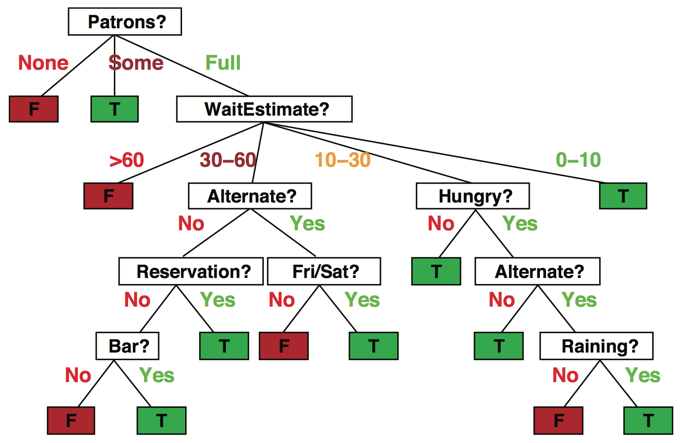
Decision trees
Popular representation for classifiers
Even among humans!
I’ve just arrived at a restaurant: should I stay (and wait for a table) or go elsewhere?

Slide 11
Decision trees
It’s Friday night and you’re hungry
You arrive at your favorite cheap but really cool happening burger place
It’s full up and you have no reservation but there is a bar
The host estimates a 45 minute wait
There are alternatives nearby but it’s raining outside
Decision tree partitions the input space, assigns a label to each partition

Slide 12
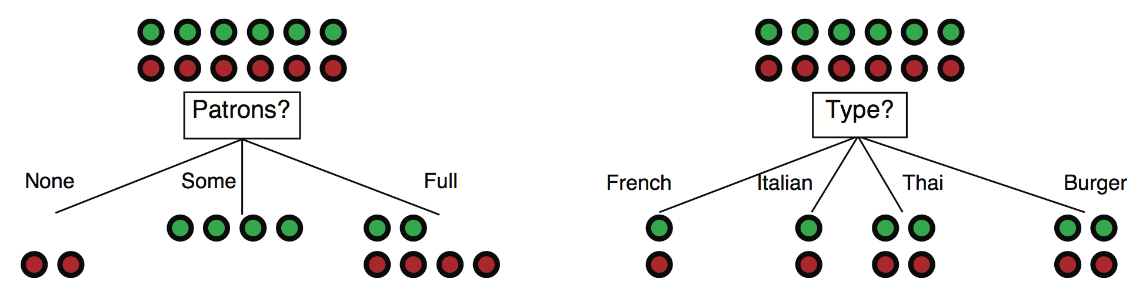
Choosing an attribute: Information gain
Idea: measure contribution of attribute to increasing “purity” of labels in each subset of examples; find most distinguishing feature
Patrons is a better choice: gives information about classification; more distinguishing feature

Slide 13
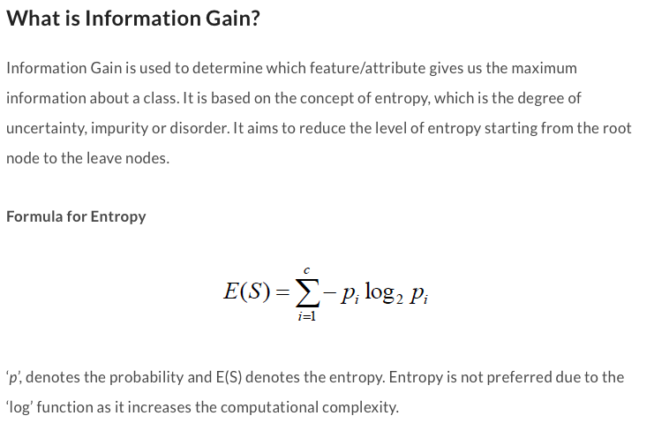

Slide 14

Information Gain
A statistical property called information gain, measures how well a given attribute separates the training examples
Information gain uses the notion of entropy, commonly used in information theory
Information gain = expected reduction of entropy
Values(A) is the set of all possible values for attribute A, and Sv the subset of S for which attribute A has value v Sv = {s in S | A(s) = v}.
the first term in the equation for Gain is just the entropy of the original collection S
the second term is the expected value of the entropy after S is partitioned using attribute A

Slide 15
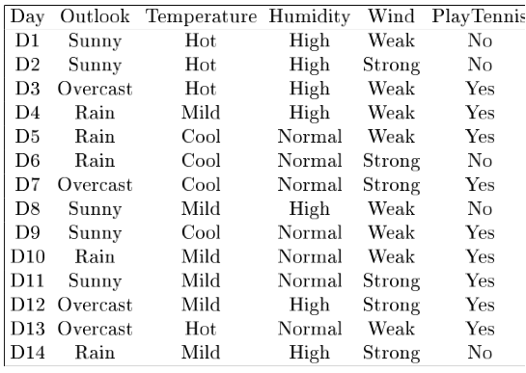
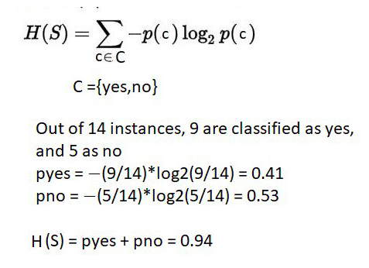
Example
Notes:
Target attrbute = playtennis

Slide 16
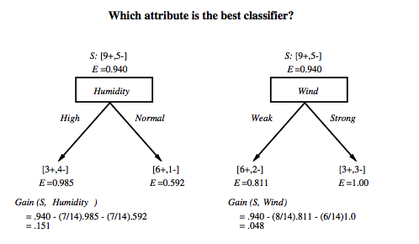
Which attribute is the best classifier?
High and Yes = 3
High and No = 4

Slide 17
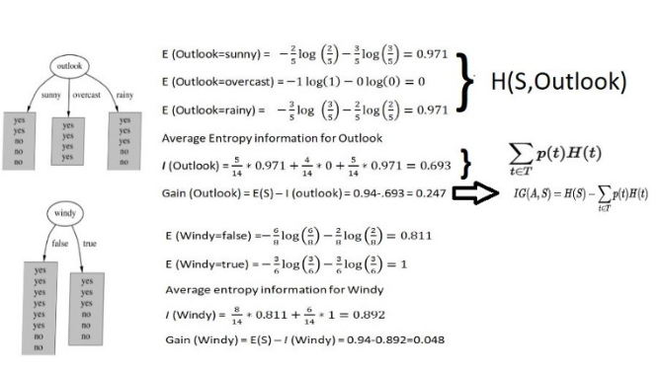

H(S, Wind).
Gain (S, Wind)

Slide 18
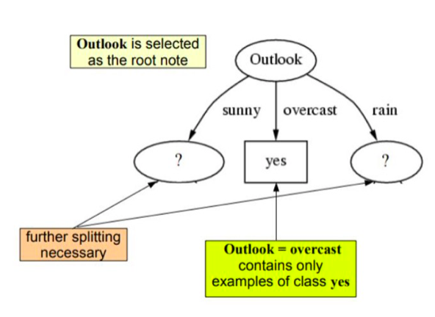
First step: which attribute to test at the root?
Which attribute should be tested at the root?
Gain(S, Outlook) = 0.247
Gain(S, Humidity) = 0.151
Gain(S, Wind) = 0.084
Gain(S, Temperature) = 0.029
The highest the better ☺
Outlook provides the best prediction for the target
Lets grow the tree:
add to the tree a successor for each possible value of Outlook
partition the training samples according to the value of Outlook

Slide 19
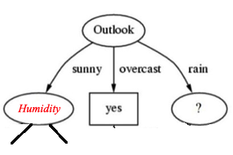
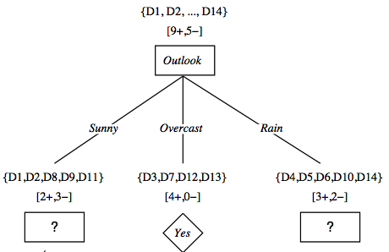
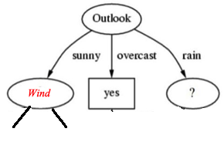
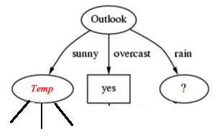
After first step
Gain(S_{Sunny}, Humidity)??
Gain(S_{Sunny}, Wind)??
Gain(S_{Sunny}, Temp)??
Entropy is 0.97
See the previous two slides

Slide 20
Second step
Working on Outlook=Sunny node:
Gain(S_{Sunny}, Humidity) = 0.970 − 3/5 × 0.0 − 2/5 × 0.0 = 0.970
Gain(S_{Sunny}, Wind) = 0.970 − 2/5 × 1.0 − 3.5 × 0.918 = 0 .019
Gain(S_{Sunny}, Temp.) = 0.970 − 2/5 × 0.0 − 2/5 × 1.0 − 1/5 × 0.0 = 0.570
Humidity provides the best prediction for the target
Lets grow the tree:
add to the tree a successor for each possible value of Humidity
partition the training samples according to the value of Humidity

Slide 21
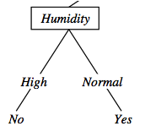
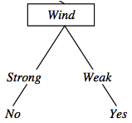
Second and third steps
{D1, D2, D8}
No
{D9, D11}
Yes
{D4, D5, D10}
Yes
{D6, D14}
No

Slide 22
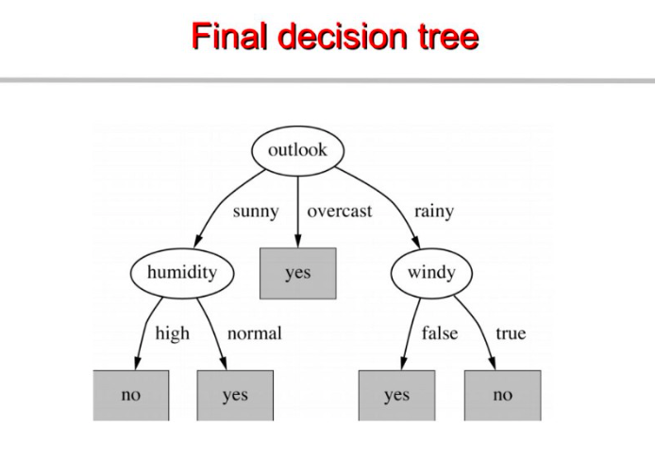

Slide 23
Sample Experience Table
Example | Attributes |  |  |  | Target
 | Hour | Weather | Accident | Stall | Commute
D1 | 8 AM | Sunny | No | No | Long
D2 | 8 AM | Cloudy | No | Yes | Long
D3 | 10 AM | Sunny | No | No | Short
D4 | 9 AM | Rainy | Yes | No | Long
D5 | 9 AM | Sunny | Yes | Yes | Long
D6 | 10 AM | Sunny | No | No | Short
D7 | 10 AM | Cloudy | No | No | Short
D8 | 9 AM | Rainy | No | No | Medium
D9 | 9 AM | Sunny | Yes | No | Long
D10 | 10 AM | Cloudy | Yes | Yes | Long
D11 | 10 AM | Rainy | No | No | Short
D12 | 8 AM | Cloudy | Yes | No | Long
D13 | 9 AM | Sunny | No | No | Medium

Slide 24
Predicting Commute Time
Leave At
If we leave at 10 AM and there are no cars stalled on the road, what will our commute time be?
10 AM
9 AM
8 AM
Stall?
Accident?
No
Yes
Long
No
Yes
Short
Long
Medium
Long

Slide 25
ID3
Given our commute time sample set, we can calculate the entropy of each attribute at the root node
Attribute | Expected Entropy | Information Gain
Hour | 0.6511 | 0.768449
Weather | 1.28884 | 0.130719
Accident | 0.92307 | 0.496479
Stall | 1.17071 | 0.248842

Slide 26
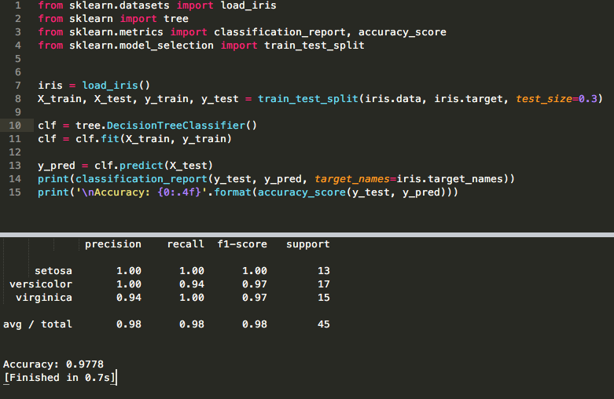

Slide 27
DT
Pros
Decision trees are easy to interpret and visualize.
It can easily capture Non-linear patterns.
the user, for example, there is no need to normalize columns.
It can be used for feature engineering such as predicting missing values, suitable for variable selection.
The decision tree has no assumptions about distribution because of the non-parametric nature of the algorithm.
Cons
Sensitive to noisy data. It can overfit noisy data.
The small variation(or variance) in data can result in the different decision tree. This can be reduced by bagging and boosting algorithms.
Decision trees are biased with imbalance dataset, so it is recommended that balance out the dataset before creating the decision tree.

